Slide 1
Gauteng district
District Treasurers Report
January 2020
25 Years

Slide 2
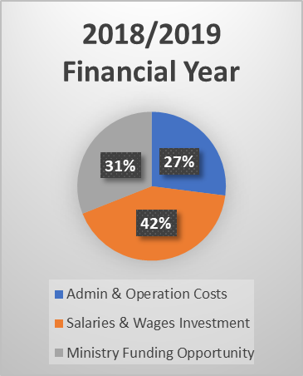
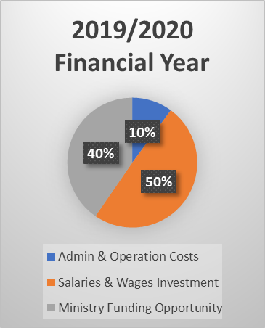
How we apportion Cost at District level

Slide 3
Highlights
R18,667.00
depreciation
10% tithe to NTC
R59,597.08
Compassionate
Ministries
R21,042.22
Church Growth &
Evangelism
R50,000
Pastoral Care
Provision for
General Assembly
Pastors & Wives retreat
Young-Pastors Seminar

Slide 4
Actual vs Budget – how did we do?
 | Budget | Actual
Income(Tithes, District Assembly and Rent) | 1,049,000 | 1,117,193
Admin & Operation Costs (office) | 305,000 | 254,688
Salaries & Wages (incl. SARS) Investment | 532,500 | 392,348
Ministry FUNDING opportunities | 209,000 | 477,954
Total Opportunities Utilised | 1,046,500 | 1,124,990
Profit/ (Loss) | 2,500 | (7,797)
Interest Received | 80 000 | 23,130
Net Profit for the Year | 82,500 | (18,667)
25th District Assembly
January 2020

Slide 5
General Obligation – towards the greater Church
Alabaster | 38,402.81
OWE | 96,271.00
Total General Budget | 134,673.81
NTC (10% of tithe received | 105,400.00
25th District Assembly
January 2020
The DFC simplified the giving structure for local churches, in that churches are to give a straight 10 % to the District (this excludes NMI offerings)
The District has budgeted for NMI, NYI, & SDMI
Growth in Tithe received from local churches 12,2%

Slide 6
Proposals:
25th District Assembly
January 2020
The following proposals are set forward for your discussion and acceptance:
On the next slide is the ‘Budget’ that has been proposed by the District Finance Committee for the 2019/2020 Financial Year. This was presented and accepted for proposal at this District Assembly by the District Advisory Board at a meeting held in November 2019. I therefore propose the attached budget for your approval.
In this Journal is the Audited Financial Report of the Church of the Nazarene Gauteng District as at 31 October 2019. These were audited by D.F. van Tonder Auditors in Montanapark. I propose that these same auditors be used for our audit at the end of this financial year.

Slide 7
2019/2020 Proposed Budget
 | Last Financial Year’s Actuals | Proposed Budget
Income(Tithes, District Assembly and Rent) | 1,117,193 | 1,185,000
Admin & Operation Costs (office) | 254,688 | 137,500
Salaries & Wages (incl. SARS) Investment | 392,348 | 650,600
Ministry FUNDING opportunities | 477,954 | 389,500
Total Opportunities Utilised | 1,124,990 | 1,177,600
Net Profit for the Year | R (18,667) | R 7,400
25th District Assembly
January 2020

Slide 8
25th District Assembly
January 2020
Thank you

